Slide 1


SSM INSTITUTE OF ENGINEERING AND TECHNOLOGY DINDIGUL - 624 002
Department of Electronics and Communication Engineering
A Deep Learning Based Approach for Grading of Diabetic Retinopathy Using Large Fundus Image Dataset
Guided By,
Mr.Manikandan A ,AP/ECE
SSMIET.
Presented By,
Keerthana T (922119106039)
Madhumitha B (922119106051)
Mahalakshmi R M (922119106052)
Malini S (922119106053)

Slide 2
PRESENTATION OUTLINE
Objectives
Introduction
Types
Literature Survey
Problem Statement of Existing System
Proposed Method
Tools and Dataset
Result for Preprocessing and Segmentation
Conclusion

Slide 3
OBJECTIVE
To classify the severity of Diabetic Retinopathy (DR) which causes severe vision loss to diabetic patient. It is classified based on Deep Learning by using Large Fundus Image Dataset.

Slide 4
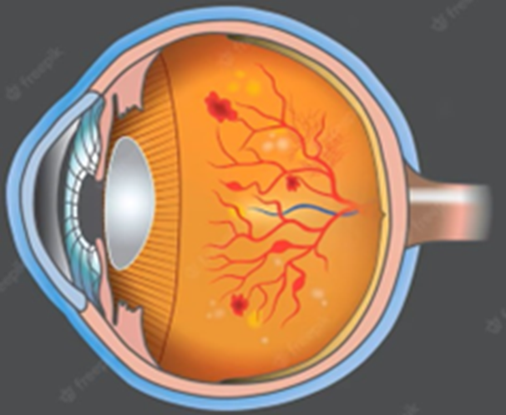
INTRODUCTION
Diabetic Retinopathy (DR) is a chronic eye disease, commonly found in elderly people (age 50 or above), and can cause severe visual impairments or even blindness.
DR is caused by the blood vessels rupturing due to high blood sugar levels.
These leaky vessels produce fluid clots and oxygen deficiency, leading to severe visual impairments
However, the progression of the disease can be reduced if diagnosed at an early stage.

Slide 5
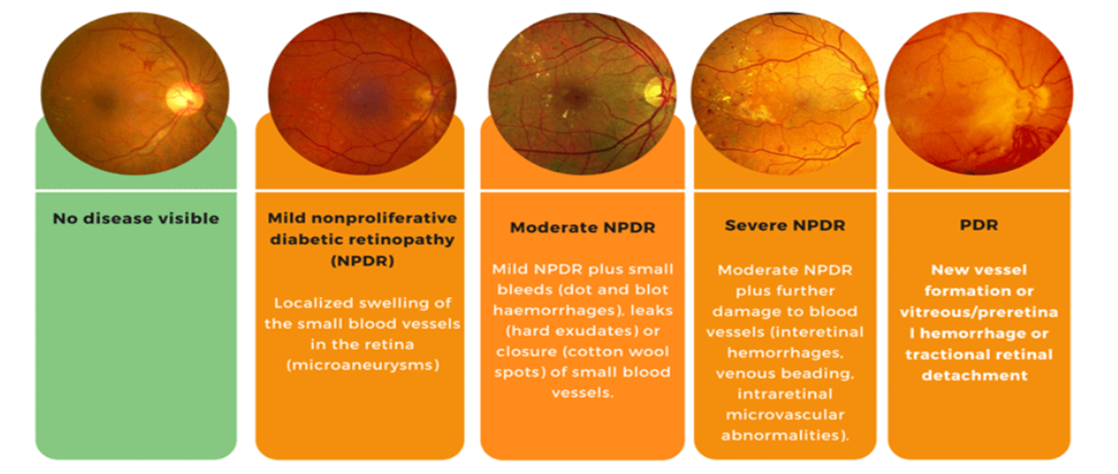
TYPES OF DIABETIC RETINOPATHY
DR is classified into two types, i.e., Proliferative and Non Proliferative Diabetic Retinopathy (NPDR).
PDR which results in complete blindness.
NPDR is graded into three stages ,
(i)Mild (ii)Moderate (iii)Severe NPDR
Severe NPDR is transmitted into PDR due to lack of proper and timely treatment.

Slide 6
LITERATURE SURVEY
S.NO | TITLE | AUTHOR NAME | YEAR OF PUBLICATIONS | METHOD
1. | Development and validation of a deep learning algorithm for detection of diabetic retinopathy in retinal fundus photographs | Mohamed,E;Abd Elmohsen | 2019 | The majority decision of all ophthalmology status are taken as majority of the ophthalmologists could not identify the correct findings for images it is difficult to perform algorithm well this is a main drawback for this paper.
2. | Development and validation of a deep learning algorithm for detection of diabetic retinopathy in retinal fundus photographs | Alexandar,R | 2020 | The original study used the EYEPACS dataset and Messidor-2 dataset to evaluate the algorithm performance. Eyepacs is a dataset which is based on the DR system to simplify process of image capture in this the main drawback is they did not provide hyper parameter settings.

Slide 7
S.NO | TITLE | AUTHOR NAME | YEAR OF PUBLICATIONS | METHOD
3. | Transfer learning based detection of diabetic retinopathy from small dataset | Farag,M.M;Abdel-Haamid | 2019 | They have used the Inception-v3 model to develop the algorithm performance and helps to extract different sized features of input images in one level of convolution.
4. | Deep learning approach to diabetic retinopathy detection | Ayesha,N;Javed,R | 2020 | It is the early detection of the diabetic retinopathy for the treatment in this automatic deep learning method is used for stage detection of single photography.
5. | Diabetic retinopathy detection and retinal image generation | Alauthman,O.M; Alkasassbeh,M | 2021 | They visualize the symptom encoded in the image and then propose the pathogen model to synthesize the retinal images ,they generate an image it may take long time but in this by using pathogen network our image takes less time and it can be used both by doctors as well as users.

Slide 8
PROBLEM STATEMENT OF EXISTING SYSTEM
There is various research gap in diabetic retinopathy autonomous detection system
The existing process to screen DR is time consuming and is hampered by the lack of trained opthalmologists.
Because of Data distortions,It is difficult to deal with all five classes at the same time.
Some research algorthims yielding problem of binary classification that is HEALTHY vs NON HEALTHY images and thus might result in the incorrect classification of severe cases
Mild non Proliferative DR is very difficult to detect as the symptoms include slowing of retinal blood flow,increased leukocytes adhesion & loss of Retinal Pericytes

Slide 9
BLOCK DIAGRAM OF PROPOSED METHOD
INPUT
PREPROCESSING
SEGMENTATION
CLASSIFICATION
OUTPUT

Slide 10
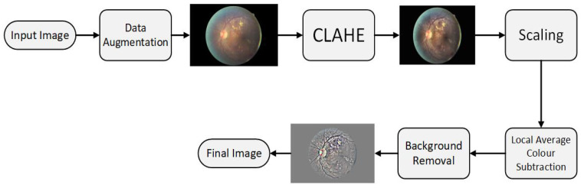
PRE PROCESSING PHASE
DATA AUGMENTATION – Flipping to 90 degree, rotating image by (0,180) degree, Translating (on scale x and y dimensions)
CLAHE – Algorithm used Contrast Limited Adaptive Histogram Equalization.
(a) Step 1 Division of image into small equal-sized partitions.
(b) Step 2 Performing histogram equalization on every partition.
(c) Step 3 Limiting the amplification by clipping the histogram at some specific value.

Slide 11
SCALING – Pixel Size [300 PIXELS OR 500PIXELS].
COLOUR NORMALIZATION AND BACKGROUND REMOVAL – Removed Background and Unwanted Details.
Gray Scale Mapping – Local Average to 50% Gray Scale image.
Resizing – Finally we Resized to 256 x 256.
Label | Grade | Percentage | Train Images | Test Images | Train Images Augmented
0 | Normal | 73% | 25,642 | 39,110 | 25,642
1 | Mild | 6.96% | 2445 | 3729 | 22,005
2 | Moderate | 15.57% | 5469 | 8342 | 21,876
3 | Severe | 2.46% | 864 | 1318 | 14,688
4 | Proliferative | 2.01% | 706 | 1077 | 12,002

Slide 12
CNN (CONVULUTION NEURAL NETWORK)
THERE IS A LIMITATION IN NEURAL NETWORK WHEN IT COMES TO DEAL WITH IMAGE.THEY BECOME EXTREMELY SLOW AT TRAINING AND PROCESSING IMAGES AND NUMBER OF IMAGE WILL ALSO BE VERY LARGE.
So,To OVERCOME THIS LIMITATION WE USED CNN IN DEEP LEARNING
WHAT IS CNN?
A CNN IS A KIND OF NETWORK ARCHITECTURE FOR DEEP LEARNING ALGORITHMS AND IS SPECIFICALLY USED FOR IMAGE RECOGNITION AND TASKS THAT INVOLVE THE PROCESSING OF PIXEL DATA.

Slide 13
SEGMENTATION – (MEDIUM FILTER )
CONVOLUTION
The input image becomes convolved with each filter and forms eight feature maps on each convolution layer.
MAXPOOLING LAYER
Max pooling is used to reduce the size of the coming feature maps intelligently so that most of the information remains same.
Reducing the number of image reduces the number of operation required to process the image.
ACTIVATION LAYER
We used a rectified linear unit (ReLU) after every convolutional and Fully Connected layer since it resulted in the highest accuracy among other activation functions and prevented the vanishing gradient problem effectively.

Slide 14
DROPOUT LAYER
Dropout technique modifies the network itself to prevent the network from overfitting.
FULLY CONNECTED LAYER
Feature maps of the last layer are then flattened, enabling them to be fed into the FC layer, where every feature value is connected to every neuron
FEATURE VECTOR
After fully connected layer,We send the extracted image to the Classifier.

Slide 15
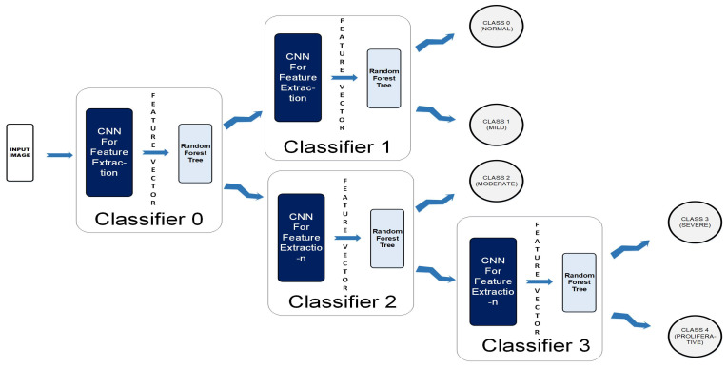
CLASSIFICATION
A Colored Fundus image is fed to the CCN as input.
The output map is sequentially forwarded from the previous one to the next four classifiers within the CCN.
The new test color fundus image moves node-wise and ultimately reaches one of the five leaf nodes (terminal nodes) for final decision-making.
Finally, it can be classified among one the five classes: Normal, Mild, Moderate, Severe, and Proliferative.

Slide 16
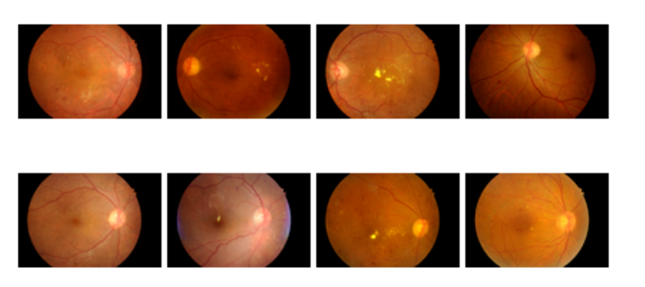
TOOL
MATLAB(2021)
DATASET
KAGGLE DATASET, which Contains 88,702 Colour fundus images, including 35,126 sample for training and 53,576 sample for testing
SAMPLE DATASET

Slide 17
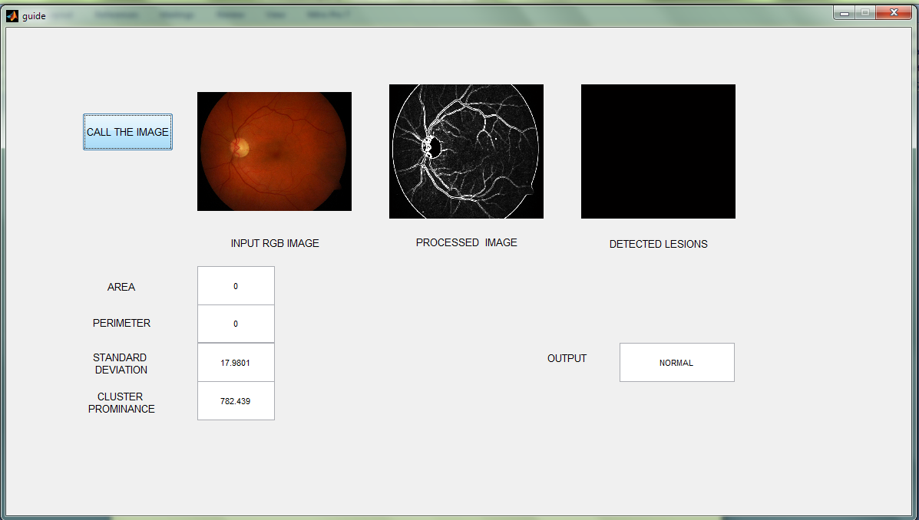
Snapshot of GUI for the Automatic Identification of a Normal Image

Slide 18
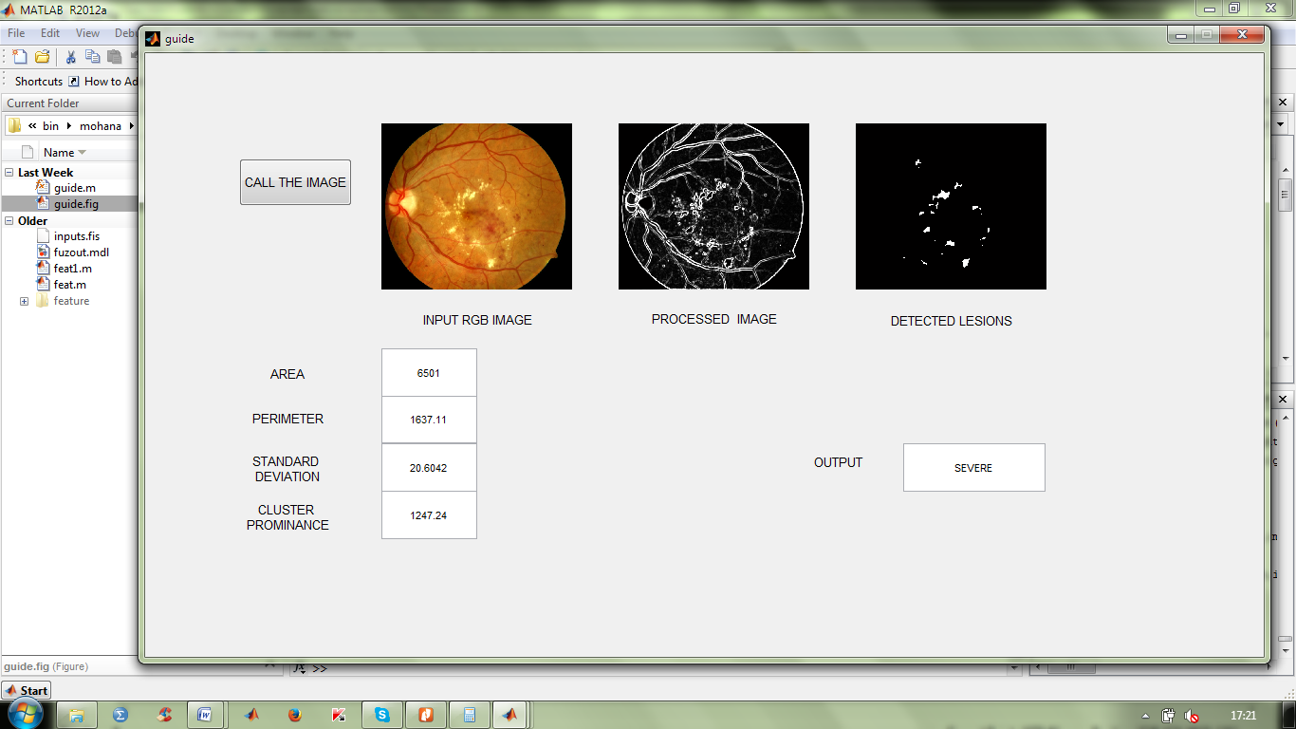
Snapshot of GUI for the Automatic Identification of an Abnormal Image

Slide 19
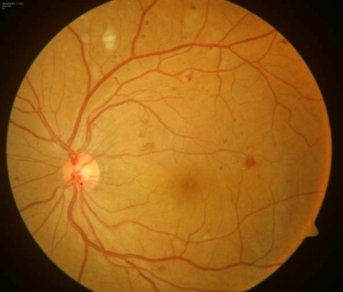
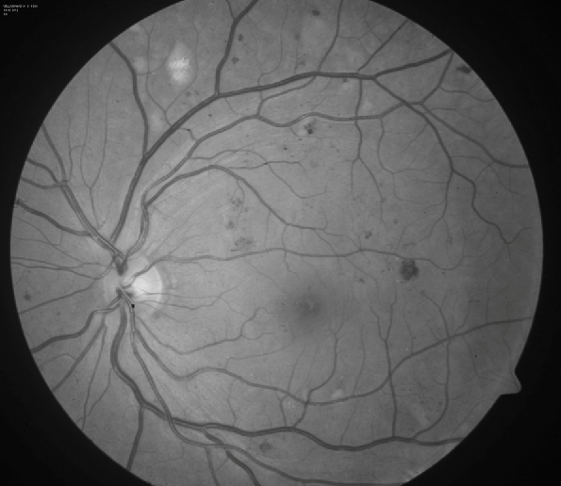
Preprocess Simulation Result

Slide 20
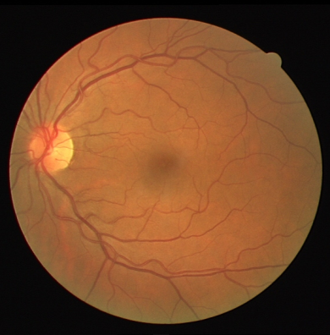
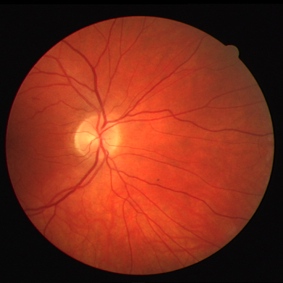
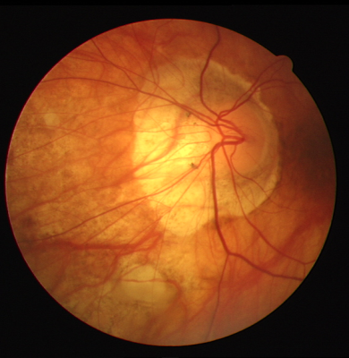
SEGMENTATION SIMULATION RESULT
Erosion and Dilation is Done

Slide 21
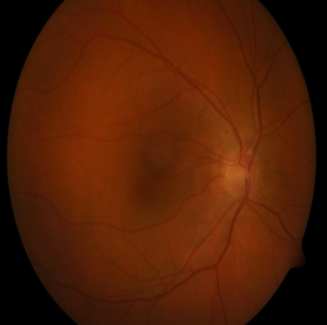
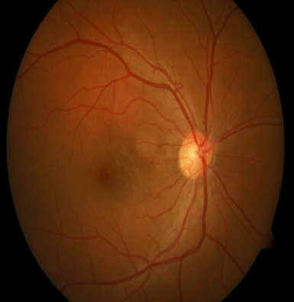
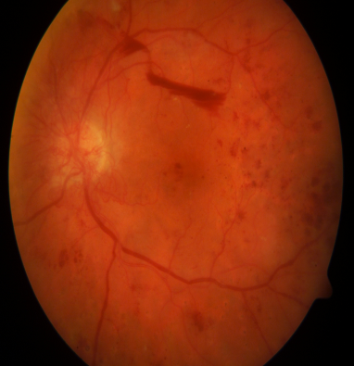

Slide 22
CLASSIFICATION
CLASSIFIER | ACCURANCY | SENSITIVITY | SPECIFICITY
RANDOM FOREST | 93 | 94 | 35
CCN | 98 | 96 | 21

Slide 23
FUTURE ENHANCEMENT
The disease’s global prevalence in estimated to rise at an exponential rate, reaching 529 million by 2030.
This is concerning for Worldwide National Health care, as affects people's ability to work, putting the economy in risk.
It greatly reduce the consumption of human resources and provide a powerful reference to the doctors to make an accurate diagnosis and detect the type of Diabetic Retinopathy.

Slide 24
CONCLUSION
The proposed algorithm categorizes a fundus image into one of the five classes of Diabetic Retinopathy
The result shows that the cascaded classifier of the convolution neural network and the random forest is a promising tool for the automatic Five Class Classification of Diabetic retinopathy
Using the cascaded system, training becomes less time-consuming, as training can be done in parallel.

Slide 25
REFERENCES:
1. Taylor, R. & Batey, D. Handbook of Retinal Screening in Diabetes: Diagnosis and Management. Wiley (2021).
2. Wang, F., Casalino, L. P. & Khullar, D. Deep Learning in Medicine-Promise, Progress, and Challenges. JAMA Intern Med. (2020).
3. Guan, M. Y., Gulshan, V., Dai, A. M. & Hinton, G. E. Who Said What: Modeling Individual Labelers Improves Classification. arXiv e-prints., https://ui.adsabs.harvard.edu/\#abs/2017arXiv170308774G. (Accessed March 01, 2020).

Slide 26
THANK YOU

